Slide 1



LION PORTAL
THE TRAVEL PLAN

Slide 2
Strategic Overview
Salesforce – Why and How?
FAQs
Action Items
Where to Get More!

Slide 3
Evolving the
Lion Digital Experience
Finding technology solutions to meet the needs of our members
Notes:
Hello, today we would like to provide an update about our digital products for Lions & Leo’s.
This presentation was prepared by LCI/LCIF staff. Questions can be sent to Salesforcefeedback@lionsclubs.org
This is a journey for all of us, your questions are encouraged!

Slide 4


What does the Lion digital experience look like today?
Notes:
Let’s start by examining our current experience
[If live presentation ask for thoughts from 4-5 members of audience]

Slide 5
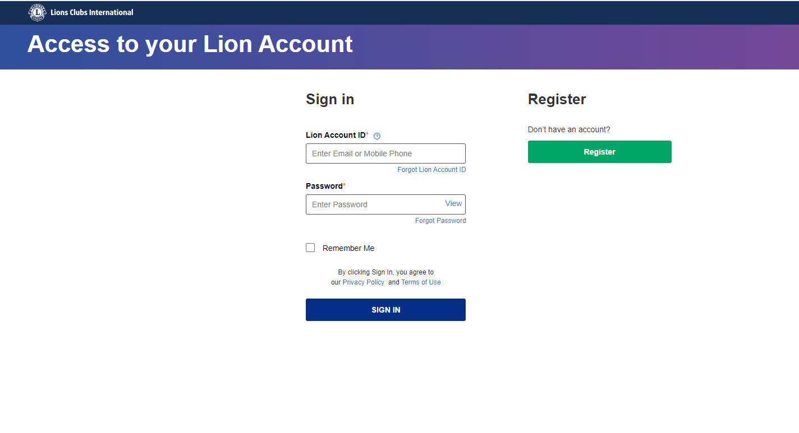
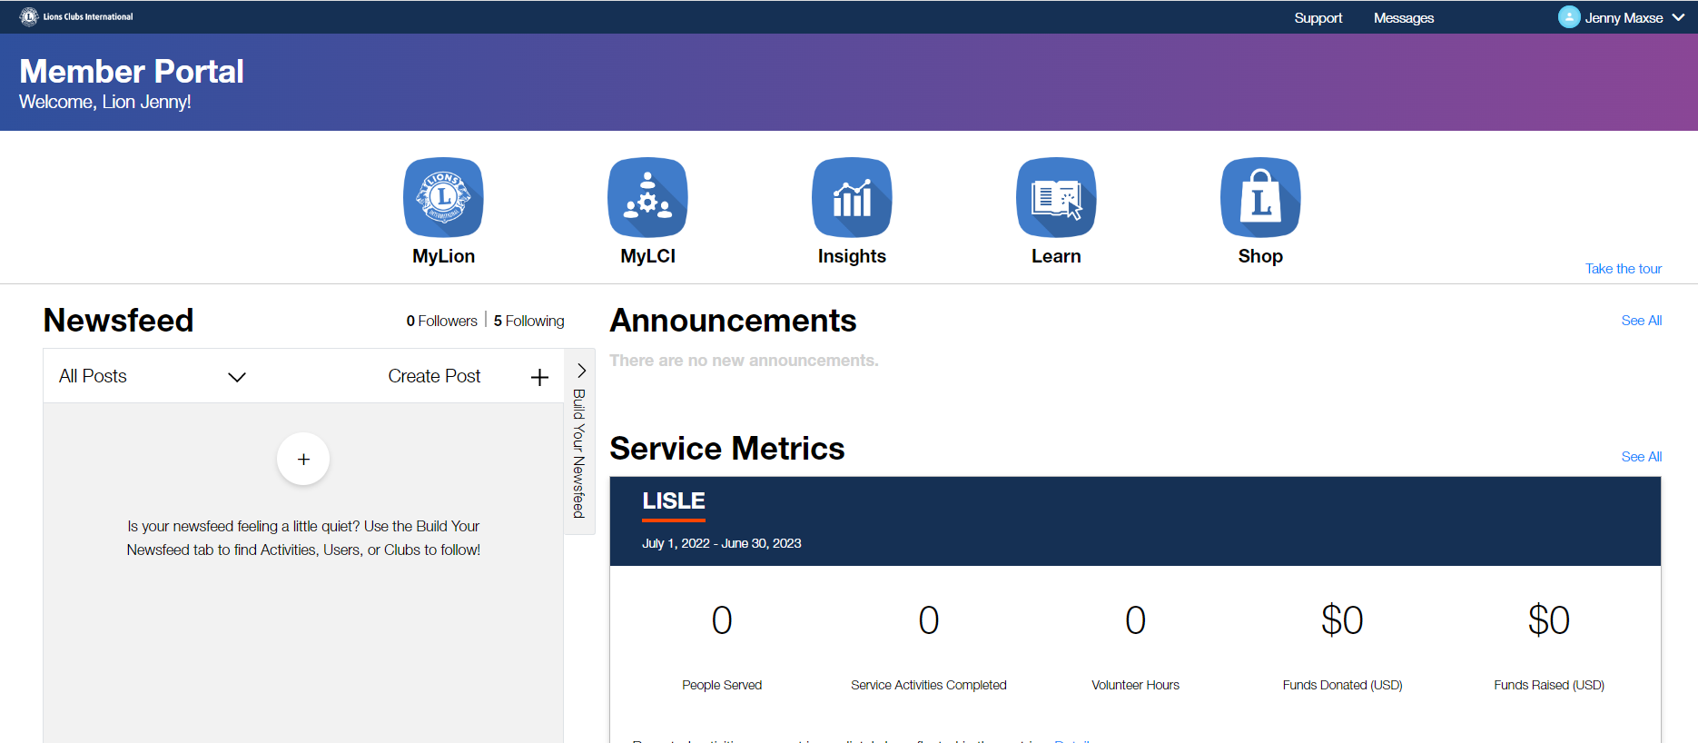
One account. One portal.
Notes:
Today we think of our Lion Account… It is one account to access all the resources you need to lead and serve.
But is it really?

Slide 6
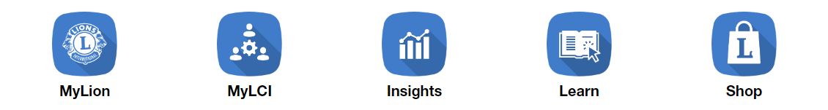
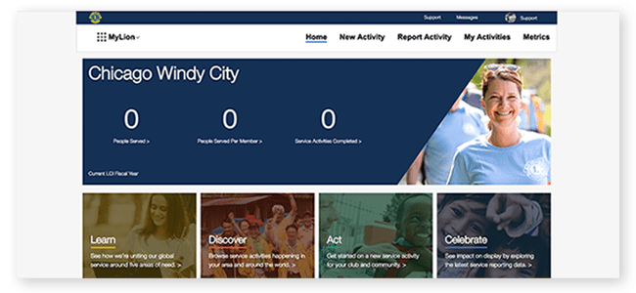
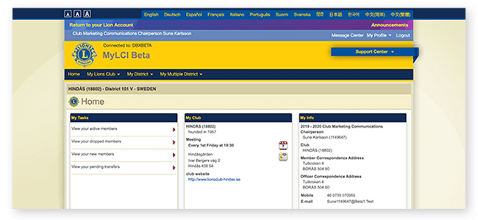
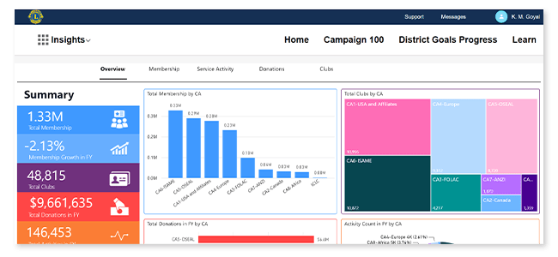
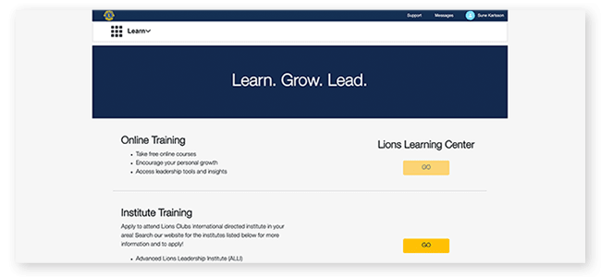
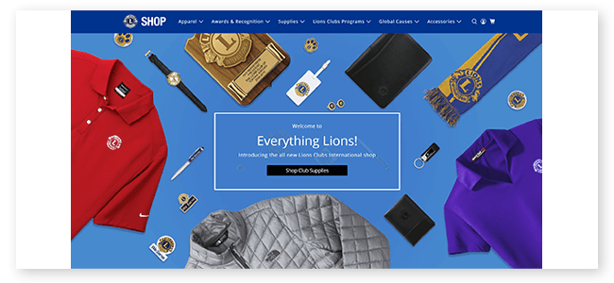
Five products. Five user experiences.
Five places to store data.
Notes:
Behind the scenes, it is five different application products. Each of these applications has their own look and feel, navigation and user experience.
Which means multiple things to learn, multiple places to try to find how to do what you need to accomplish.
Further, this relies on multiple independent data bases that often do not have the same data.
The multiple data stores add significant complexity in securing and managing you have the proper and compliant access to the data you need.

Slide 7




Even with the current portal, many other interactions are completely disconnected
Inquiries to the Member Service Center
Viewing detailed donation history
Individual and Club Recognitions & Awards
Grants Applied & Awarded
Notes:
Even with our current digital tools, many of your other interactions are completely disconnected from your “Lion account”. When you need assistance from the Member Service Center, they are working from an independent application without integrated data.
There is very limited donation information available today, which often means a call or inquiry to the Foundation to get the question answered about the status of an award or recognition.
Speaking of recognitions, it can also be very confusing to find the report that may have the data you are seeking and when no report exists you may have to call someone for help. Taking a long time to get an answer to a simple question.
Finally, today there are still highly manual functions like applying for and reporting on a grant supporting the critical work you are doing. This makes the process take longer with much more effort.

Slide 8











Creating an inconsistent and frustrating experience
Supplies & Shop
Payments & History
Convention & Delegates
New Member
New Club
Club Recognitions
Reporting
Individual Recognitions
Service Planning
Learning & History
Club Management
Grants Applied & Awarded
Donations Made
Member
Services
Individual Member
Notes:
It takes a great deal of work to manage a club, support the growth and development of an area/district, and deliver services to those in need. Our current digital tools with multiple applications and data sources have made this an inconsistent and frustrating experience at all levels.
The last major investment in digital tools was over five years ago, and technology has continued to advance, even faster during the pandemic. And we need to advance our technology to better help you serve.

Slide 9
Where are we headed?
Notes:
This leads to the question of “Where are we headed”.

Slide 10

In mid 2023, we are moving to one streamlined digital experience.
Bringing Together Lions Applications & Data
Notes:
In our past fiscal year, your international board approved investment in moving forward with modernizing our digital tools to simplify our solutions by unifying Lions applications and data into one cohesive and consistent experience.
Behind the scenes work has been in progress over the past months and will continue into early 2023 toward a launch of an improved experience in mid 2023.
This is an evolution, guided by lessons learned, feedback from Lions and leveraging new, more secure commercially available cloud-based software.

Slide 11

We are taking the functionality of our current digital tools and evolving the overall experience.
One Lion account.
One member portal.
One streamlined user experience across all your devices; phone, tablet, and computer.
One technology platform powering it all.
Notes:
This evolution takes our existing capabilities and implements them into one unified experience. Allowing access from one Lion account, to a consistent user interface, providing a unified experience with all capabilities available across your computer, tablet or mobile device. To put it simply, we’re taking the functionality you have today with MyLion, MyLCI, Insights and some other tools and combining them into one cohesive and consistent experience — all built on a single platform: Salesforce.
Salesforce is the industry leader in cloud solutions used by more than 150,000 organizations, including over 40,000 nonprofit entities. We are in good company, with significant support of this proven technology.

Slide 12
How do we get there?
Together.
Notes:
So how do we make this transition? How will we jointly get there? By working through this change together.
Your involvement is key. So how can you get involved to let your voice be heard?

Slide 13
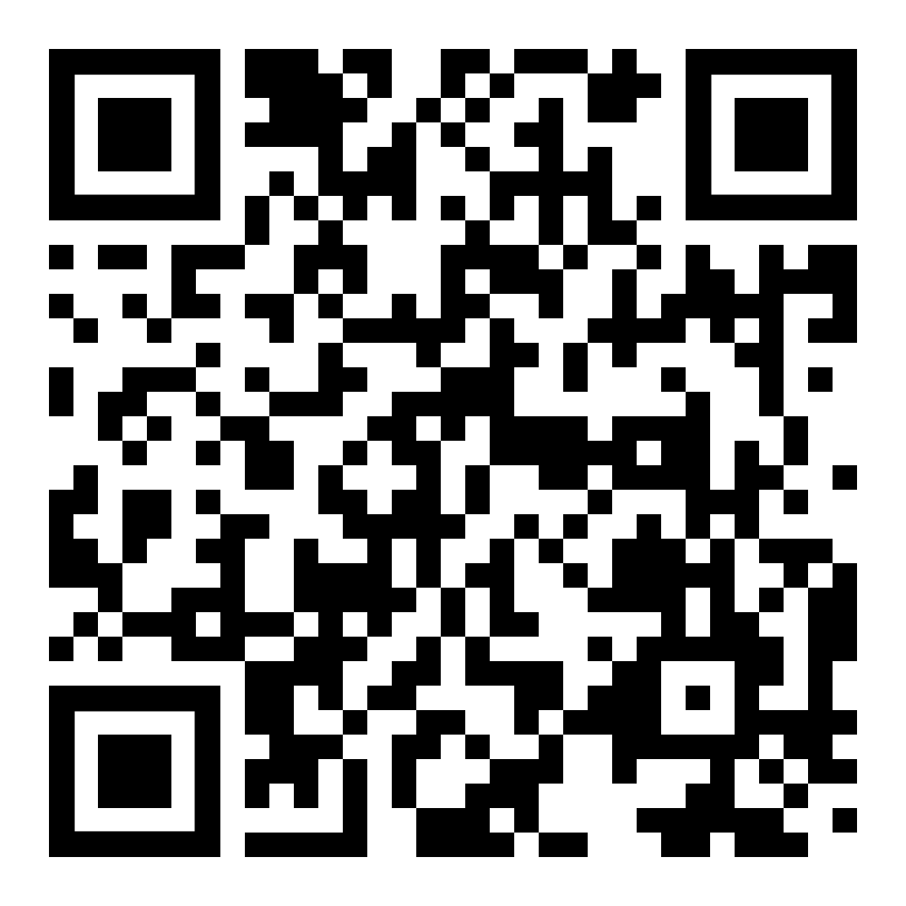
How can you get involved?
Sharing your input helps us keep a pulse on how technology can help you do what you do best — lead and serve.
Use the QR code to take the technology
usage survey
We want to know what’s important to you.
Club websites
Mobile experiences
Service reporting
Service activity discovery
Networking and communicating
with members
Social media integrations
Document search
Fundraising tools
Managing data and preferences
Accessibility tools and support
Digital tools education and support
Other …
Sign-up to stay informed
Participate in focus groups
Notes:
Sharing your input and staying involved is key!
Use the QR code to take the technology use survey. This asks about how you use all types of technology at every level of participation; member to leader, to do the work you do in support of our shared mission.
At the conclusion of the survey, you can sign-up for informational updates or to participate in focus groups and testing teams.
We need your participation to develop solutions that work for you.

Slide 14
Salesforce
– Why and How?
Notes:
Sharing your input and staying involved is key!
Use the QR code to take the technology use survey. This asks about how you use all types of technology at every level of participation; member to leader, to do the work you do in support of our shared mission.
At the conclusion of the survey, you can sign-up for informational updates or to participate in focus groups and testing teams.
We need your participation to develop solutions that work for you.

Slide 15
CRM Solutions to Power Your Purpose
Salesforce.org provides powerful CRM* technology for a global community of nonprofits and educational institutions to help them operate effectively, raise funds, and build more meaningful relationships with those they serve.
*Customer Relationship Management
Notes:
Sharing your input and staying involved is key!
Use the QR code to take the technology use survey. This asks about how you use all types of technology at every level of participation; member to leader, to do the work you do in support of our shared mission.
At the conclusion of the survey, you can sign-up for informational updates or to participate in focus groups and testing teams.
We need your participation to develop solutions that work for you.

Slide 16
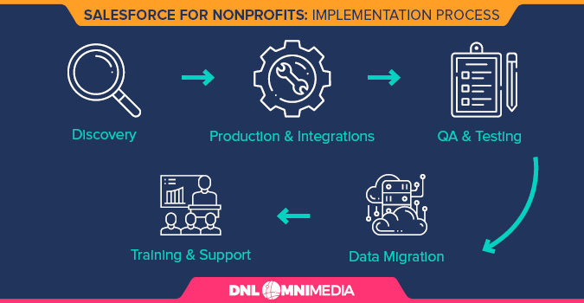
Notes:
Sharing your input and staying involved is key!
Use the QR code to take the technology use survey. This asks about how you use all types of technology at every level of participation; member to leader, to do the work you do in support of our shared mission.
At the conclusion of the survey, you can sign-up for informational updates or to participate in focus groups and testing teams.
We need your participation to develop solutions that work for you.

Slide 17
Notes:
Sharing your input and staying involved is key!
Use the QR code to take the technology use survey. This asks about how you use all types of technology at every level of participation; member to leader, to do the work you do in support of our shared mission.
At the conclusion of the survey, you can sign-up for informational updates or to participate in focus groups and testing teams.
We need your participation to develop solutions that work for you.

Slide 18
FAQs
Notes:
Sharing your input and staying involved is key!
Use the QR code to take the technology use survey. This asks about how you use all types of technology at every level of participation; member to leader, to do the work you do in support of our shared mission.
At the conclusion of the survey, you can sign-up for informational updates or to participate in focus groups and testing teams.
We need your participation to develop solutions that work for you.

Slide 19
What’s changing with the digital tools I’m using as a Lion?
  We’re combining MyLion, MyLCI and Insights, along with some additional tools and functionality, into a unified experience called the Lion Portal. The new portal will offer the same features and functionality currently available, but with a more consistent and efficient experience.
When will the new Lion Portal launch?
  We’re targeting a mid-2023 launch, but will share more details in the coming months. A preview of the system will be offered prior to the launch.
Will I be able to use my Lion Account credentials to access the new system?
  To ensure the security of your account, current Lion Account passwords are encrypted. This means we cannot see them or port them over into a new system. Because of this, we will prompt you when it’s time to update your Lion Account credentials — your username and password — to access the Lion Portal. Please note that we can no longer support the use of telephone numbers as usernames, so you will need to use a unique email — one that is only used by you — and create a new password to log in.
Notes:
Sharing your input and staying involved is key!
Use the QR code to take the technology use survey. This asks about how you use all types of technology at every level of participation; member to leader, to do the work you do in support of our shared mission.
At the conclusion of the survey, you can sign-up for informational updates or to participate in focus groups and testing teams.
We need your participation to develop solutions that work for you.

Slide 20
How will the new Lion Portal differ from the old products?
  The new portal is an evolution of our current digital tools. MyLion, MyLCI and Insights won't be available when you log into the new portal. Instead, you’ll access the various functions you performed in those products directly from the homepage. For example, rather than clicking into MyLion to report your service, you’ll access service reporting directly from the main portal page.
  The new portal is built on Salesforce, a commercially available platform used by over 150,000 organizations, including 40,000 nonprofits. Salesforce is the recognized industry leader in relationship management systems and will allow us to offer a rich and continually improving digital experience.
Will the Learn tool be moved to the new Lion Portal?
  Learn will be accessible through the new Lion Portal. So, once you use your new Lion Account credentials to login, you’ll click on Learn and it will lead you into the same Learn tool we have today.
Notes:
Sharing your input and staying involved is key!
Use the QR code to take the technology use survey. This asks about how you use all types of technology at every level of participation; member to leader, to do the work you do in support of our shared mission.
At the conclusion of the survey, you can sign-up for informational updates or to participate in focus groups and testing teams.
We need your participation to develop solutions that work for you.

Slide 21
What else will I be able to do in the new Lion Portal?
  In addition to reporting service, managing club rosters, accessing reports and all the other functionality you currently have through MyLion, MyLCI and Insights, the new Lion Portal will provide a centralized location to access a variety of data and tools ranging from your LCIF donation history to our Member Service Center FAQs. More information to come on this in the coming months.
What functions will I be able to access in the new Lion Portal?
  Just as it is today, your access to specific data and tools is based on any Lions positions you hold.
Will I still be able to access the old products (MyLion, MyLCI, Insights) once the new portal is live?
  MyLion, MyLCI and Insights as you know them today will not be available once the new Lion Portal is live. However, the same functionality of those tools will be available. For example, instead of clicking on MyLCI to access your member roster, you’ll be able to click into a member reporting section on the main portal page where you can access your roster. The functions will no longer be housed within separate tools.
Notes:
Sharing your input and staying involved is key!
Use the QR code to take the technology use survey. This asks about how you use all types of technology at every level of participation; member to leader, to do the work you do in support of our shared mission.
At the conclusion of the survey, you can sign-up for informational updates or to participate in focus groups and testing teams.
We need your participation to develop solutions that work for you.

Slide 22
Will the Lion Portal be mobile-friendly?
  Yes! Whether using your desktop, laptop, tablet or mobile phone, you’ll have access to the same functionality in the Lion Portal. The portal will simply be adjusted to fit the size of the device.
Is the new system secure? Will my data be safe?
  Yes, the new system is built on Salesforce, which offers Salesforce Shield — an extremely powerful and secure suite of data-privacy and encryption tools.
Is training available to help me learn how to use the new Lion Portal?
  The Lion Portal will include in-product training at launch so you can learn while exploring the updated experience. In addition, we'll continually be looking to develop training solutions based on the needs of Lions and Leos.
Where do I go for help if I have questions?
  Please reach out to the product team with the question at salesforcefeedback@lionsclubs.org.
Notes:
Sharing your input and staying involved is key!
Use the QR code to take the technology use survey. This asks about how you use all types of technology at every level of participation; member to leader, to do the work you do in support of our shared mission.
At the conclusion of the survey, you can sign-up for informational updates or to participate in focus groups and testing teams.
We need your participation to develop solutions that work for you.

Slide 23
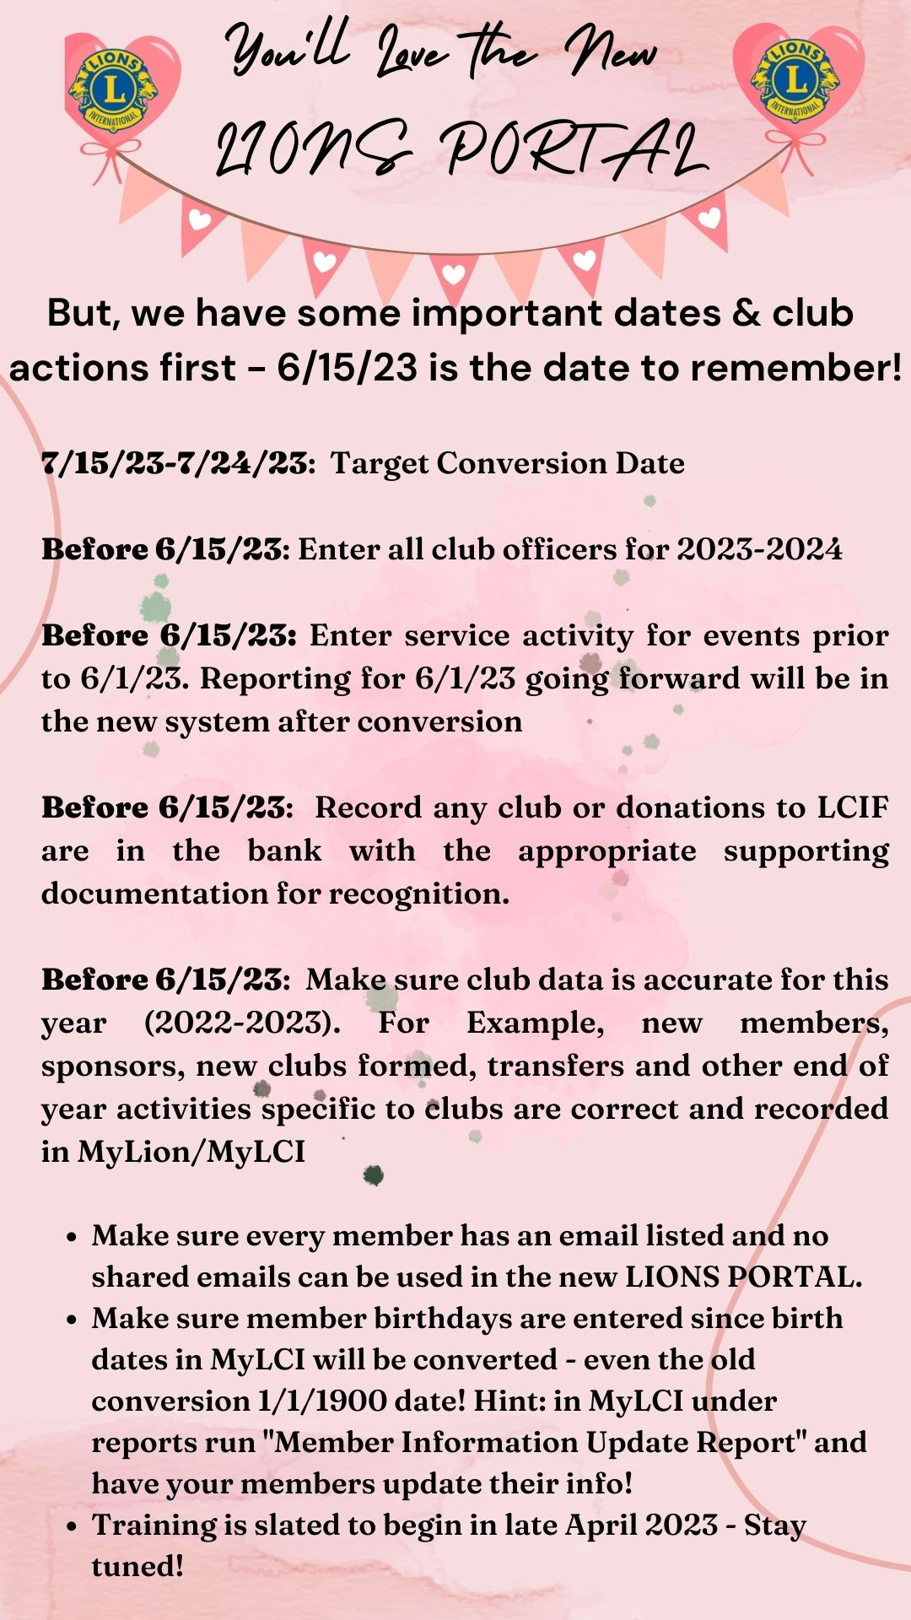
Notes:
Sharing your input and staying involved is key!
Use the QR code to take the technology use survey. This asks about how you use all types of technology at every level of participation; member to leader, to do the work you do in support of our shared mission.
At the conclusion of the survey, you can sign-up for informational updates or to participate in focus groups and testing teams.
We need your participation to develop solutions that work for you.

Slide 24
How do I get to the new Lion Portal?
  You can use the same links (https://account.lionsclubs.org) and bookmarks you’ve been using for the current portal to get to the new Lion Portal.
Copies of this presentation and documents are at:
    Lions International District 2-S2 - Lion Portal (lions2s2.org)

Slide 25
THANK YOU FOR YOUR ATTENTION
ANY QUESTIONS?

